Slide 1

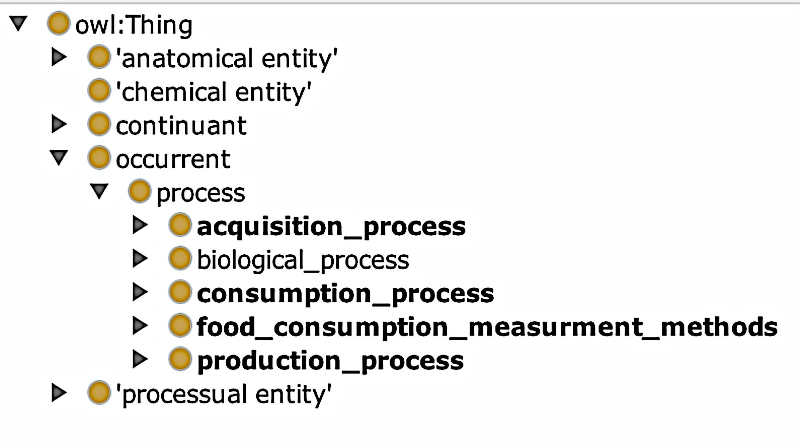
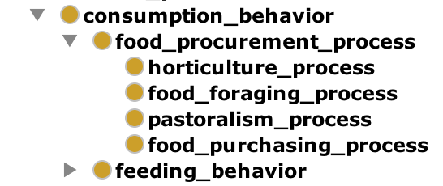
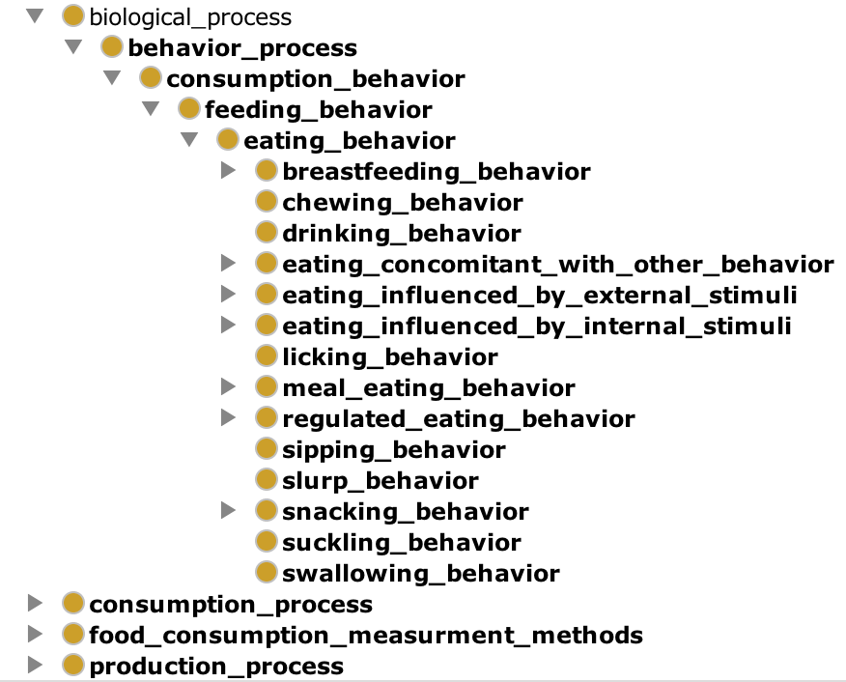
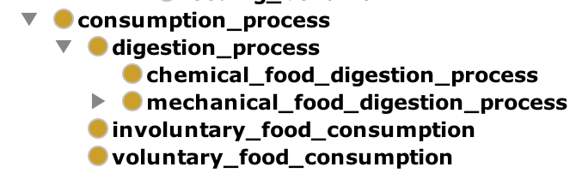
uc_Eating: An Ontology for unambiguous characterization of Eating and Food Habits
Kimiya Taji, Matthew Lange PhD
University of California, Davis, 95616
Abstract
The uc_Eating ontology is a standardized unambiguous characterization system for modeling human food habits and eating processes. The uc_Eating ontology along with the physiological, environmental, behavioral, and food ontologies it maps to, provide an infrastructure for annotating the relationships between food, food consumption, eating behaviors, and environments creating a foundation for computable knowledge bases around food and beverage consumption scenarios, their observation, interrogation, and manipulation at biological, behavioral, and environmental levels.
Introduction
Open world assumptions of semantic web ontology languages (OWL) provide a means for capturing the diverse array of human food consumption behaviors.
The construction of the food habit knowledge model enables the quantification and characterization of individual eating patterns.
Ontologies provide infrastructure for annotating relationships between food consumption and eating behaviors, providing the encoding of the unambiguous uc_Eating knowledge model into tractable and computable vocabularies.
Food consumption practices often facilitate sharing of culture and bringing together of people in a social setting.
Features such as eating habits, social and psychological influences, as well as nutritional condition, were considered when building our model of eating behaviors.
The uc_Eating ontology is located on Github as part of the IC-FOODS repository of ontologies dedicated to ontologies related to Food Systems, Food, Behavior, and Health.
.
Results
Design and Methods
We used Protégé a ontology design software to create the uc_Eating ontology.
Types, costs, frequencies of foods consumed, times, locations and settings of food consumption, internal/external influences on consumption, and physiological consumption process itself inhere in eating behaviors and essential characteristics Part of human nature involves the ability to make decisions on what to eat based on the environmental and social influences.
The base class “meal eating behavior” characterizes numerous types of meals consumed by individuals including, celebratory meal, post workout meal, feasting meal, religious meal, and holiday meal behaviors.
Compensatory meal behaviors involve food consumed to compensate for sleep, stress, physical activity and for other foods consumed.
The entity “eating concomitant with other behavior” enables classification of eating while engaging in other activities.
The base class “snacking behavior” consists of distinctive types of snacking behavior delineating when- snacking take place: after school, late-night, mid-day, etc.
Regulated eating behaviors classify the drivers behind why people consume various types of foods according to prescriptive diets.
1
A
2
B
4
C
D
Biological process, acquisition process, consumption process, production process and food consumption measurement methods act as a subclass for occurrent process. Eating behaviors are classified as a either a single occurrent or regarded as co-occurrents
Consumption behavior contains subclasses food procurement process and fedding behvaior
Classificaion of various eating behaviors that take place along with relationships
Consumption process consists of concomitant biological and environmental processes making up eating
Eating patterns and the consumption of food help create a means for identifying disease progression.
Foods consumed vary by individual preferences and lifestyle choices recognized by the uc_Eating ontology.
Moving forward, patterns of eating behaviors can be classified into eating behavior pattern phenotypes.

